Slide 1
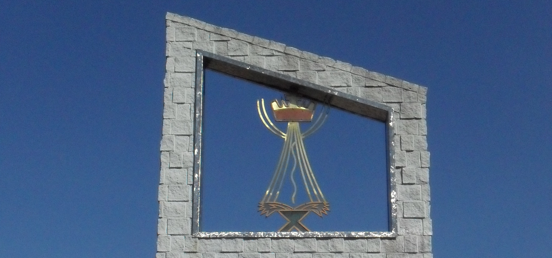
WELCOME TO IMMANUEL LUTHERAN CHURCH

Slide 2


Slide 3
Communion Accessibility
We try to accommodate everyone
who worships with us at Immanuel.
If for any reason
you are unable to commune at the altar,
please inform an usher,
and we will bring communion to you.

Slide 4


Slide 5


DO YOU
NEED THE PRAYER CHAIN?
Contact
Kristine Ball
at 356-9316

Slide 6
DO YOU NEED A RIDE TO CHURCH?
The Board of Social Ministry
provides FREE rides, on DIAL-A-RIDE,
to and from our 10:30 Sunday services.
Contact Dave Meyer at 354-5864
For more information.

Slide 7



A new 13 week session begins Wednesday, September 5th
at 5:00 P.M.
in the Youth Room.
Please contact Carol Boyd (354-3758)
or Dave Meyer (354-5864)
for more information.

Slide 8

Join our friendly outdoor gathering,
for food and fun,
at Michekewis pavilion.
Friday, September 7, 5:30 – 7:30 P.M.
Check the bulletin for more information.
Lay Minister / Usher Gathering

Slide 9

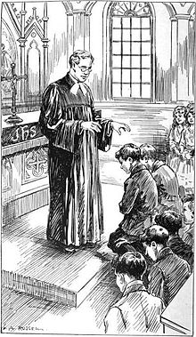
An orientation meeting
for parents and students
is set for Wednesday, September 5
6:00 – 6:30 P.M.
** See the bulletin for more information.
Confirmation Orientation Meeting

Slide 10

Pew Sisters - Journey to the Cross
Pew Sisters will meet one more
Saturday morning at Cabin Creek
on September 8 at 9:00 A.M.
In October, they will return back
to their Monday evening schedule.

Slide 11

“SHAPED BY THE GOSPEL:
LIFE IN THE CHURCH”
This Youth/Adult Bible study
begins September 9 at 9:15 A.M.
in the church fellowship room.
The study is based on letters written by the Apostle Paul to young Timothy, to give him guidance on the issues of church life.
This 12-week study is led
by Pastor Schultz and Pastor Erickson.

Slide 12

Close the Back Door meets
every Thursday at 6:00 P.M.
in the library/lounge area
of the Church
Join Pastor Erickson
for this important outreach ministry.
CLOSE THE BACK DOOR

Slide 13

“UNSHAKABLE”
A new 12-week Bible study by Max Lucado
begins September 9 at 9:15 A.M.
Deacon Al Kersten will lead this short
DVD/workbook based study.
Check next week’s bulletin for the location.

Slide 14



EARLY BIRD BIBLE STUDY
Monday mornings at 7:00 A.M.
at the Thunder Bay River Restaurant.
Our current study is the book of 1 KINGS.
** We will not meet on September 3
due to the Labor Day holiday!

Slide 15

L.W.M.L.
meeting
Monday, September 10, 2018
at 6:30 P.M.
in the church fellowship room.

Slide 16
MEN’S BREAKFAST & BIBLE STUDY
Begins Saturday, September 15 at 7:30 a.m.
in the church fellowship room.
Menu:
Eggs, sausage, sweet rolls, and coffee
This breakfast will be hosted
every 2nd Saturday of the month
by the Board of Lay Ministry.

